Slide 1






06​-2088-302
imcoffee.ezk@gmail.com
© 2020 by Imcoffee. Proudly created with Wix.com
Follow us:

Slide 2

06​-2088-302
imcoffee.ezk@gmail.com
© 2020 by Imcoffee. Proudly created with Wix.com
Follow us:

Slide 3

06​-2088-302
imcoffee.ezk@gmail.com
© 2020 by Imcoffee. Proudly created with Wix.com
Follow us:

Slide 4

06​-2088-302
imcoffee.ezk@gmail.com
© 2020 by Imcoffee. Proudly created with Wix.com
Follow us:

Slide 5

06​-2088-302
imcoffee.ezk@gmail.com
© 2020 by Imcoffee. Proudly created with Wix.com
Follow us:

Slide 6
06​-2088-302
imcoffee.ezk@gmail.com
© 2020 by Imcoffee. Proudly created with Wix.com
Follow us:

Slide 7



最新消息
News
菜單專區
Menu
門市據點
locations
線上購物
Store
會員專區
Member
LATEST NEWS
06​-2088-302
imcoffee.ezk@gmail.com
© 2020 by Imcoffee. Proudly created with Wix.com
Follow us:

Slide 8

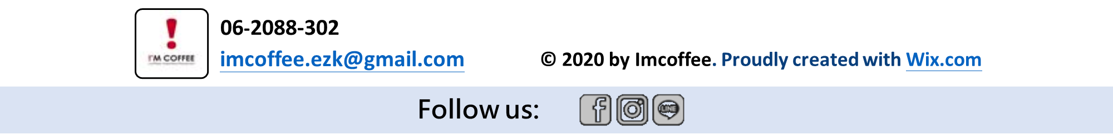
最新消息
News
菜單專區
Menu
門市據點
locations
線上購物
Store
會員專區
Member
LATEST NEWS

Slide 9

最新消息
News
菜單專區
Menu
門市據點
locations
線上購物
Store
會員專區
Member
LATEST NEWS

Slide 10

最新消息
News
菜單專區
Menu
門市據點
locations
線上購物
Store
會員專區
Member
LATEST NEWS

Slide 11

最新消息
News
菜單專區
Menu
門市據點
locations
線上購物
Store
會員專區
Member
LATEST NEWS

Slide 12

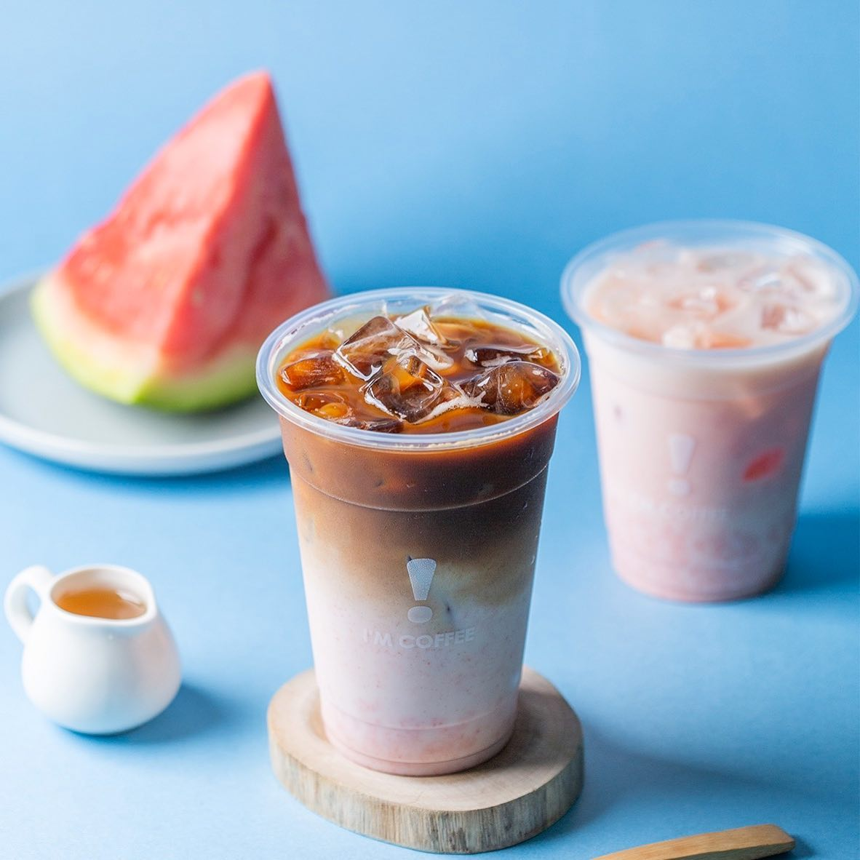
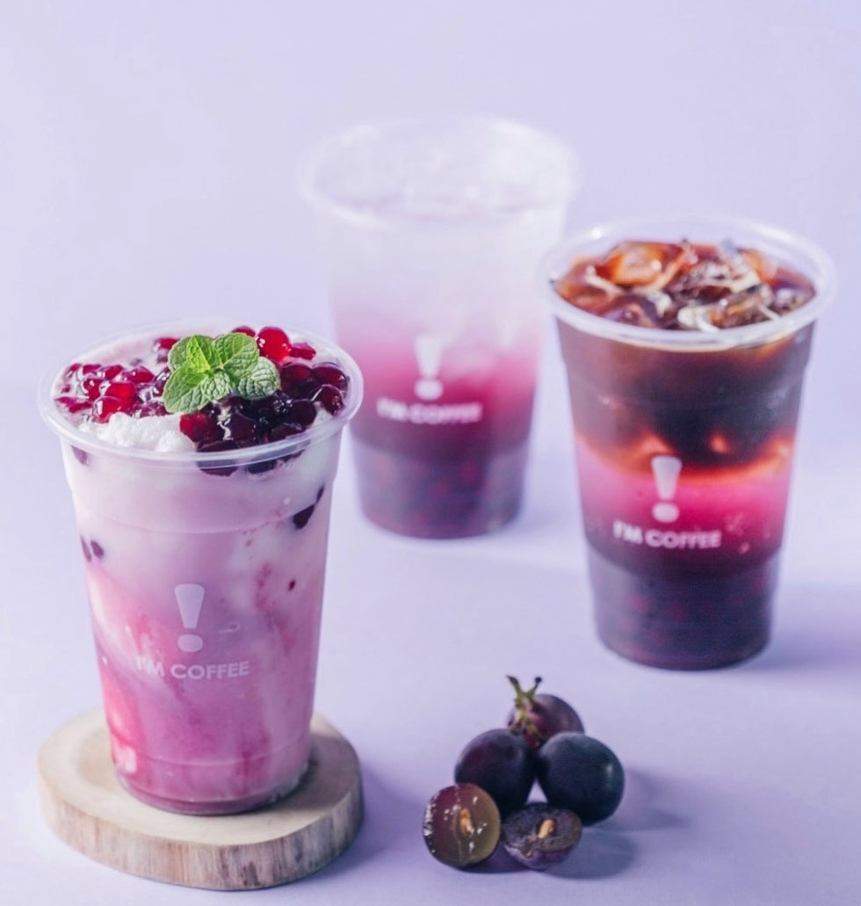
最新消息
News
菜單專區
Menu
門市據點
locations
線上購物
Store
會員專區
Member
NEWS
最新消息
Oct.24.2023
Oct.27.2023
Oct.31.2023
LEARN MORE
LEARN MORE
LEARN MORE

Slide 13

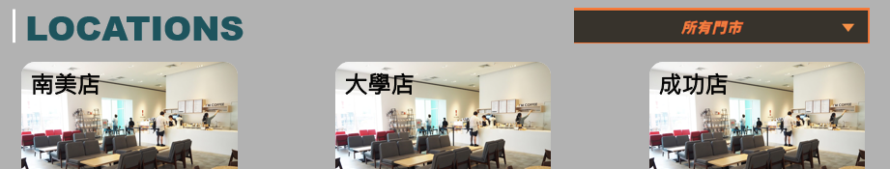
最新消息
News
菜單專區
Menu
門市據點
locations
線上購物
Store
會員專區
Member

Slide 14

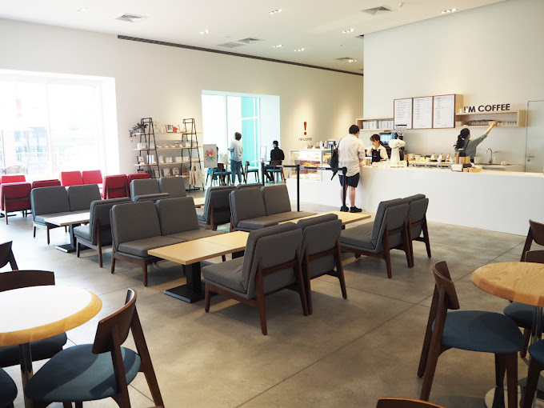
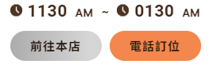
最新消息
News
菜單專區
Menu
門市據點
locations
線上購物
Store
會員專區
Member
locations
南美店
大學店
成功店

Slide 15
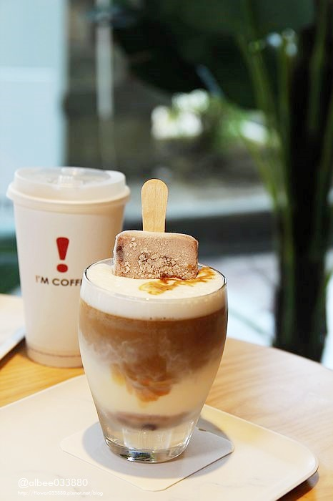
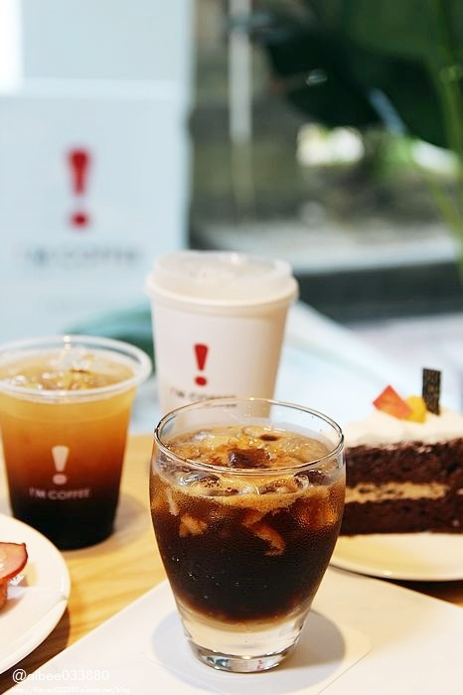
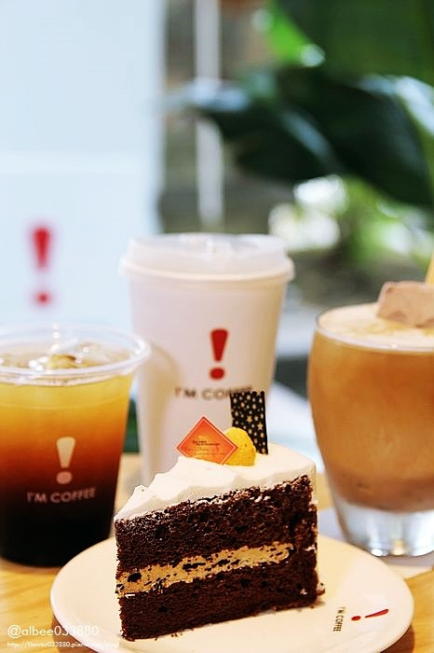
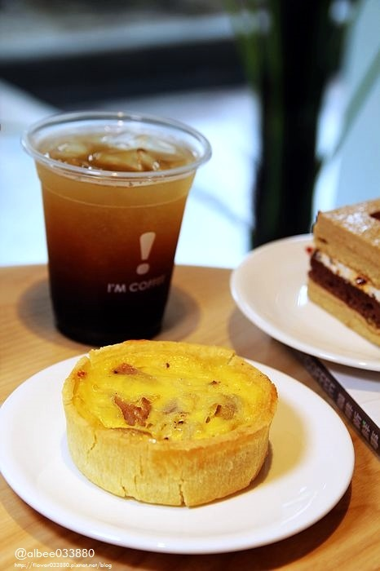
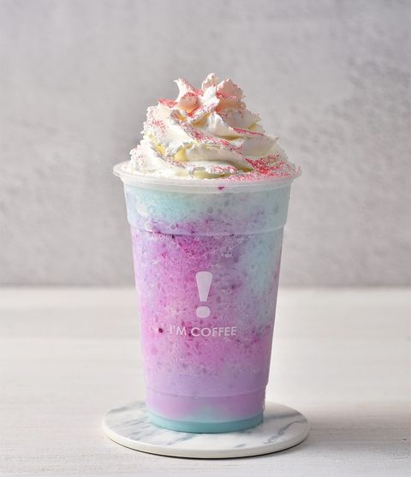
最新消息
News
菜單專區
Menu
門市據點
locations
線上購物
Store
會員專區
Member
IG
社群
IG asdfasdf

Slide 16
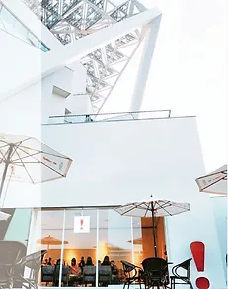


最新消息
News
菜單專區
Menu
門市據點
locations
線上購物
Store
會員專區
Member
菜單專區
查看菜單
Menu
精粹
輕食
氣泡飲
濃縮咖啡
手沖咖啡
SMOOTHIE
輕食及風味飲

Slide 17
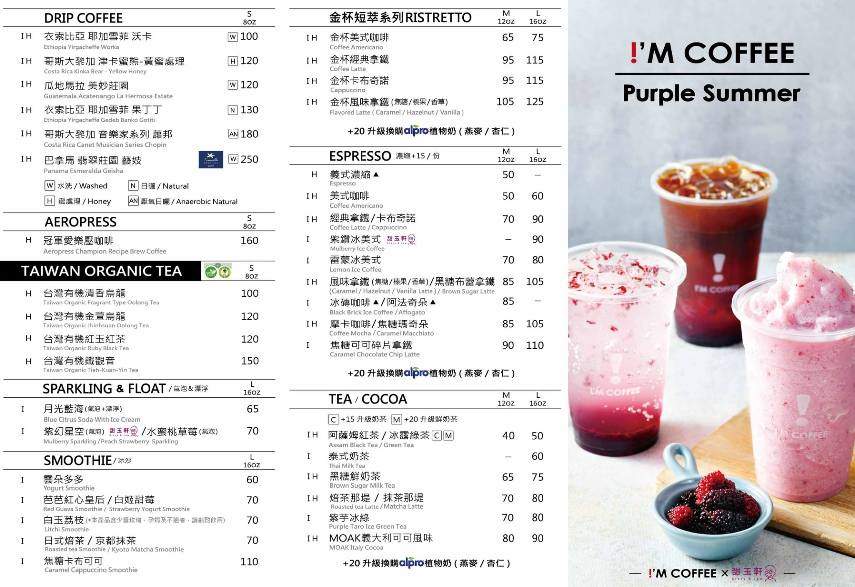
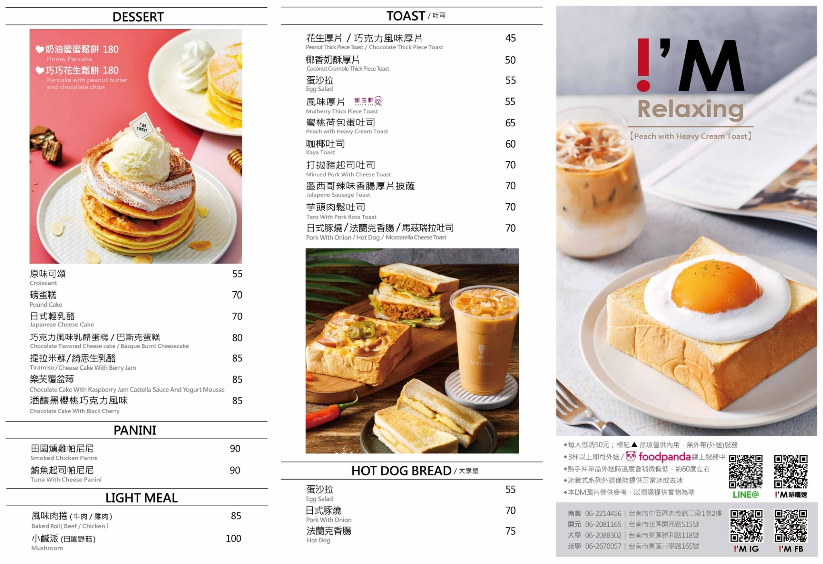
最新消息
News
菜單專區
Menu
門市據點
locations
線上購物
Store
會員專區
Member

Slide 18
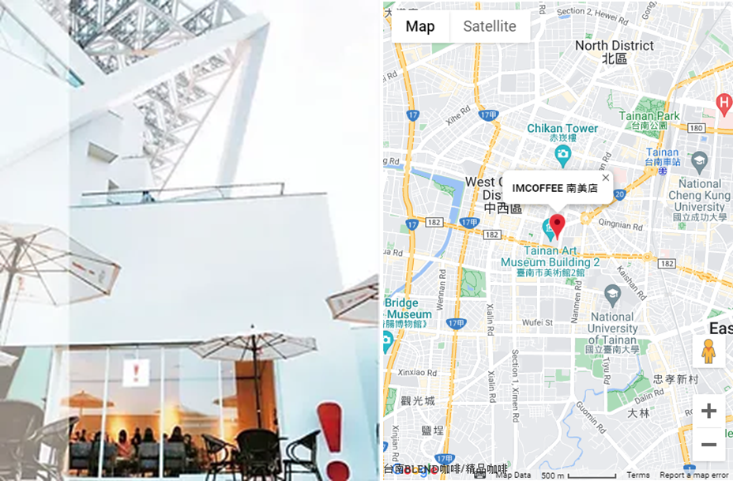
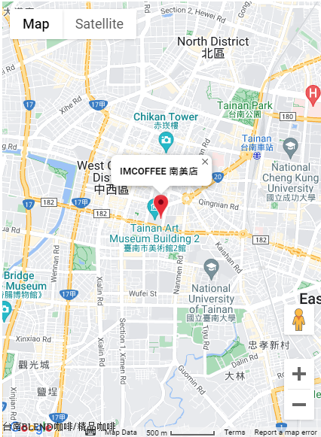

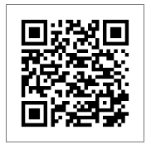
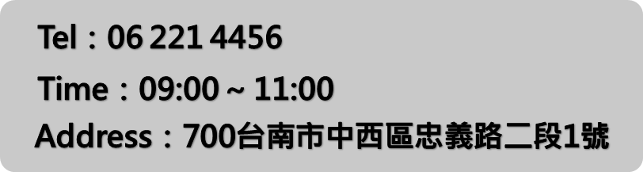
最新消息
News
菜單專區
Menu
門市據點
locations
線上購物
Store
會員專區
Member
!‘M COFFEE 南美店
© 2020 by Imcoffee. Proudly created with Wix.com

Slide 19
最新消息
News
菜單專區
Menu
門市據點
locations
線上購物
Store
會員專區
Member
>
會員專區 Member
加入會員
會員登入
此功能動作

Slide 20
最新消息
News
菜單專區
Menu
門市據點
locations
線上購物
Store
會員專區
Member
此功能動作
LATEST NEWS
>
會員專區 Member
加入會員
會員登入

Slide 21
最新消息
News
菜單專區
Menu
門市據點
locations
線上購物
Store
會員專區
Member
>
會員專區 Member
加入會員
會員登入
NEWS
此功能動作
最新消息
Oct.24.2023
Oct.27.2023
Oct.31.2023
LEARN MORE
LEARN MORE
LEARN MORE

